Slide 1
Employee Management System
Group 24
Group Members:
Bhavsar Darshan Vijaykumar(19BECE30028)
Prachi Jethava(19BECE30140)
Jain Shreyas Sunilkumar(19BECE30183)
Project Guide: Barkha Bhavsar

Slide 2
Problems Faced in Real World
Resumes are always time taking to skim for recruiters.
A lot of time is invested to select employees and maintain and fetch structured data.
In the current scenario, this work is done manually which is a tedious job for HR.

Slide 3
Problem Statement
Most of the time the CV is reviewed manually by the HR department which consumes a lot of time. Thus, the idea is to build a place where data is being fetched in a structured way for recruiters as well
Along with that job recommendations are also provided to the job seekers according to their skills.
Portal is also maintaining details of every employee of the company.

Slide 4
Approach
Using the NLP concepts the resume is parsed and details of the candidate are extracted using NER and python libraries.
For the job role recommendation, an ML model is used that is trained on data that is web scraped.
A web application will be built which is integrated with the model.

Slide 5
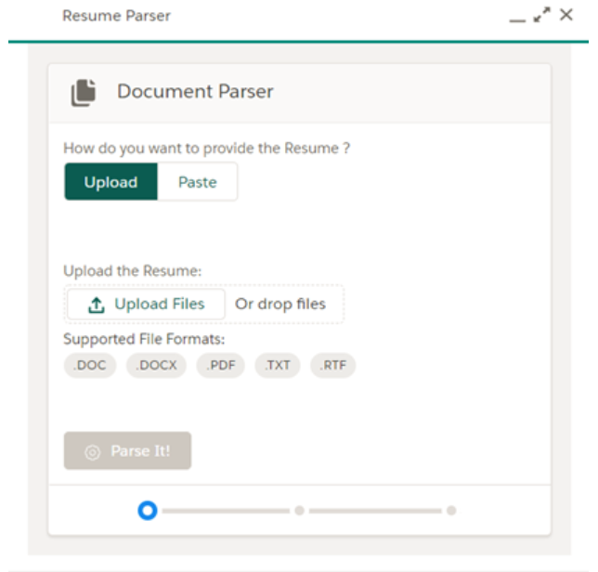
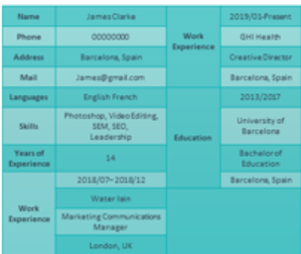





Workflow
Entities
Structured Data
Extracted Data
Libraries
and NER
Storage
Parser
Skills
ML Model
Trained Data
Job Role Recommendation
User
Output
Resume

Slide 6
Impact
Can give better analysis with accuracy.
Proves beneficial to reduce human efforts.
Saves a lot of time for the recruiters.

Slide 7
Tech and Tools
NLP- Python libraries like pyresparser, spacy and RE is used
ML Model- Sci-kit learn and jupyter notebook
Backend- Django framework
Frontend- HTML, CSS, JavaScript

Slide 8
Future Prospects
Job recommender can be used as an extension.
Candidates can also be provided with the skills to include in their resume for better job suggestions.
Detail fetching can be made possible to build dynamic according to the recruiter’s choice.

Slide 9
Thank You!

